Slide 1
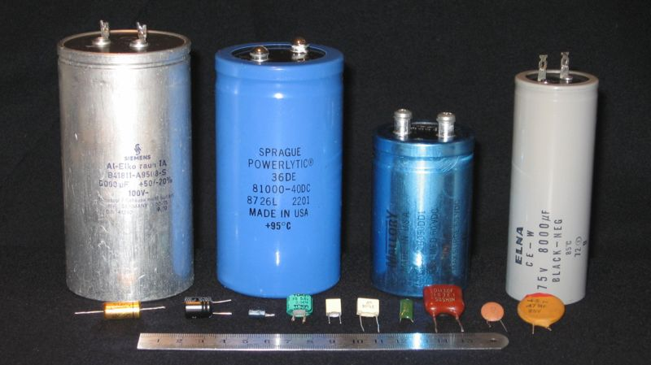
Section 6: Capacitance

Slide 2
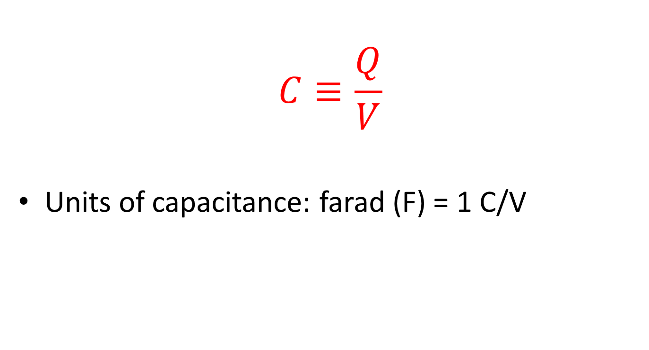
Capacitance: Definition
$$C≡\frac{Q}{V}$$
Units of capacitance: farad (F) = 1 C/V

Slide 3
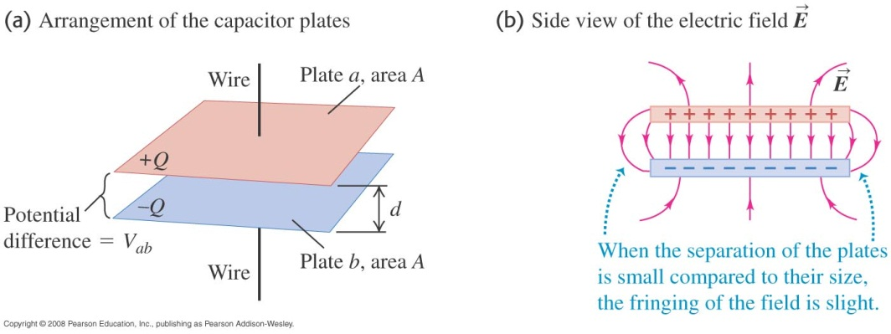
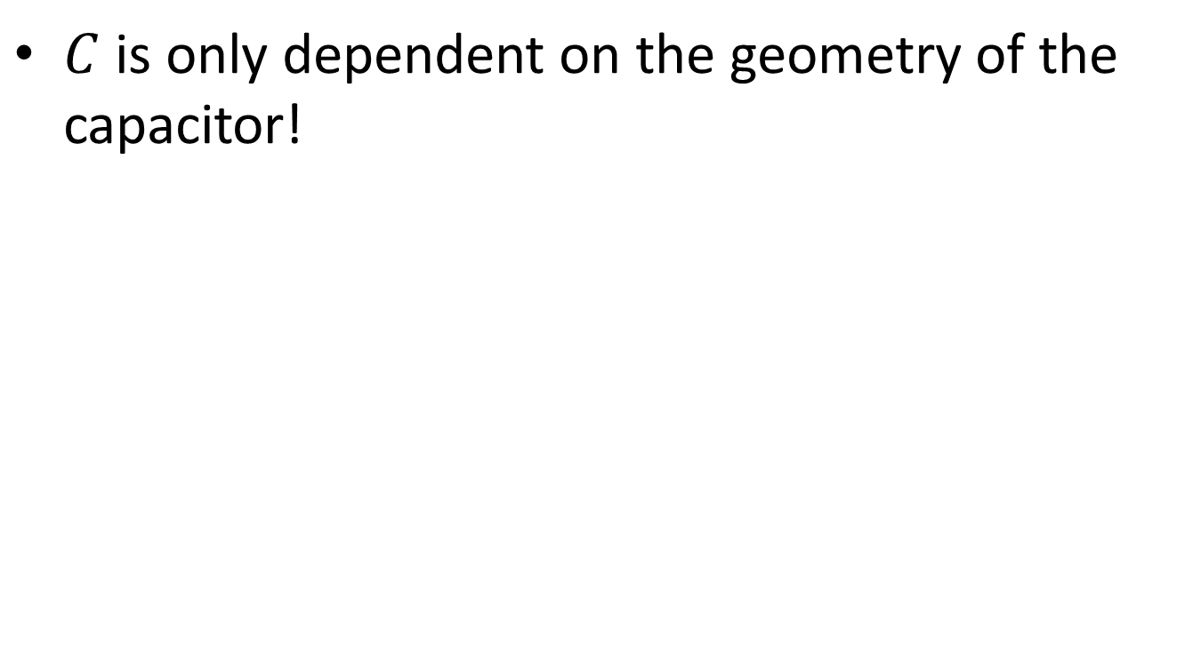
Capacitance
$C$ is only dependent on the geometry of the capacitor!

Slide 4
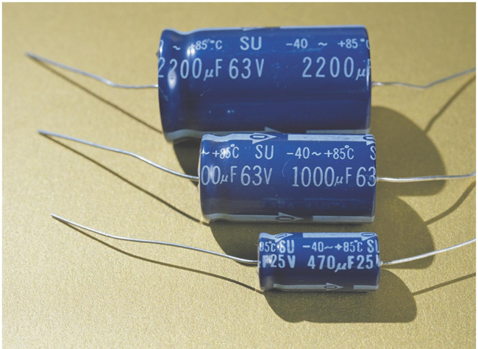
Capacitance Units
A farad (1 C/V) is very large on every day scales!
Pass out some capacitors!

Slide 5
Example Problem: Parallel Plate Capacitor

Slide 6
Activity: Parallel Plate Capacitance

Slide 7
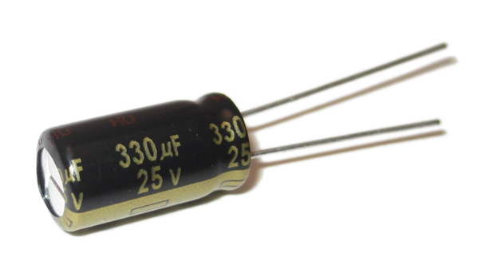
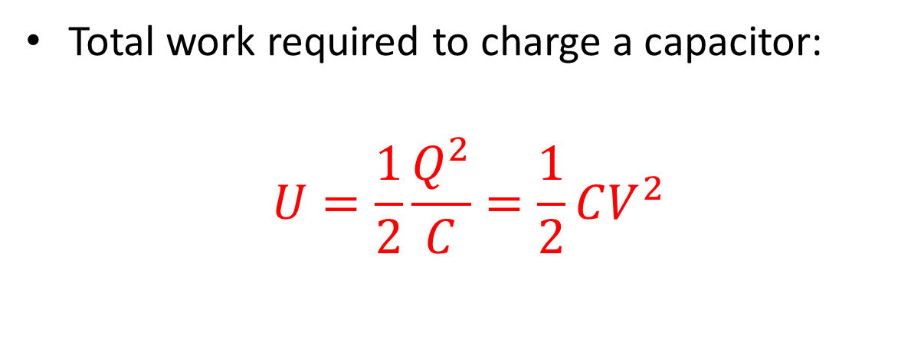
Energy Stored in a Capacitor
Total work required to charge a capacitor:
$$U=\frac{1}{2}\frac{Q^{2}}{C}=\frac{1}{2}CV^{2}$$

Slide 8

Example Problem: Energy Storage
How much energy does the capacitor in the picture store at its maximum allowed voltage?

Slide 9
Activity: Capacitor Charge and Energy

Slide 10
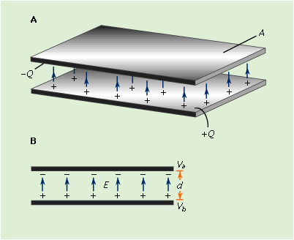
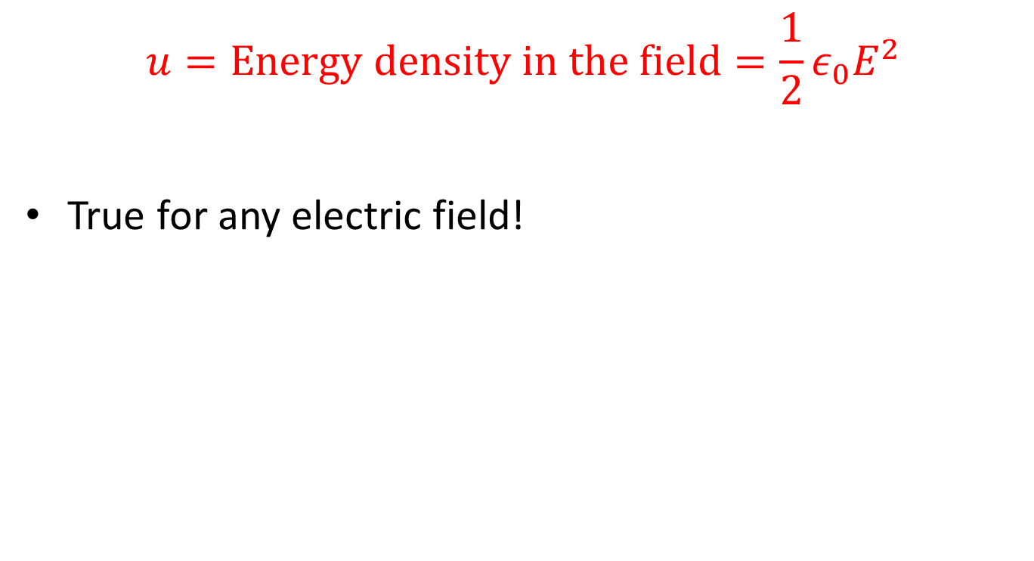
Energy Stored in the Electric Field
$$u=\text{Energy} \text{density} \text{in} \text{the} \text{field}=\frac{1}{2}ε_{0}E^{2}$$
True for any electric field!

Slide 11
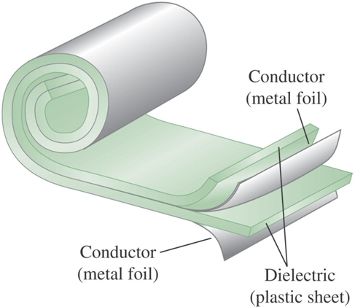
Dielectrics
Dielectric: An insulator placed in between the capacitor plates

Slide 12
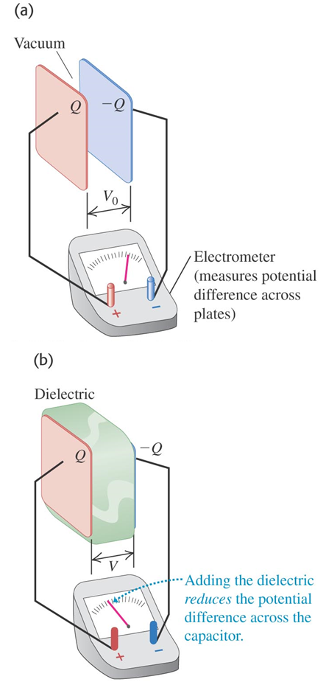

Dielectrics
WHY??

Slide 13
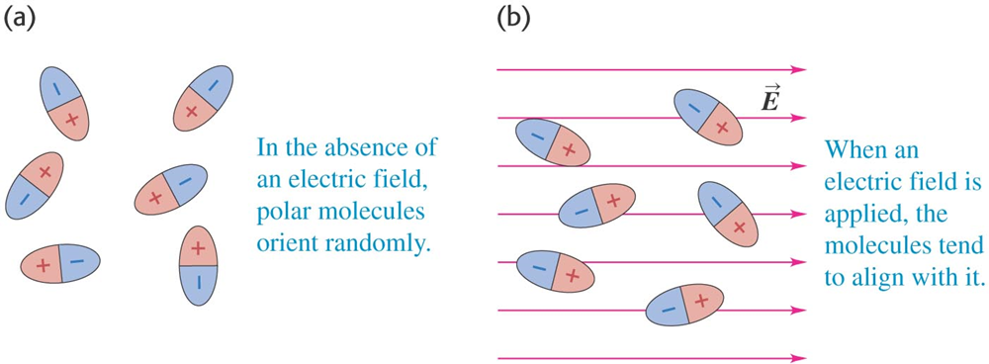
Review: Polarization

Slide 14
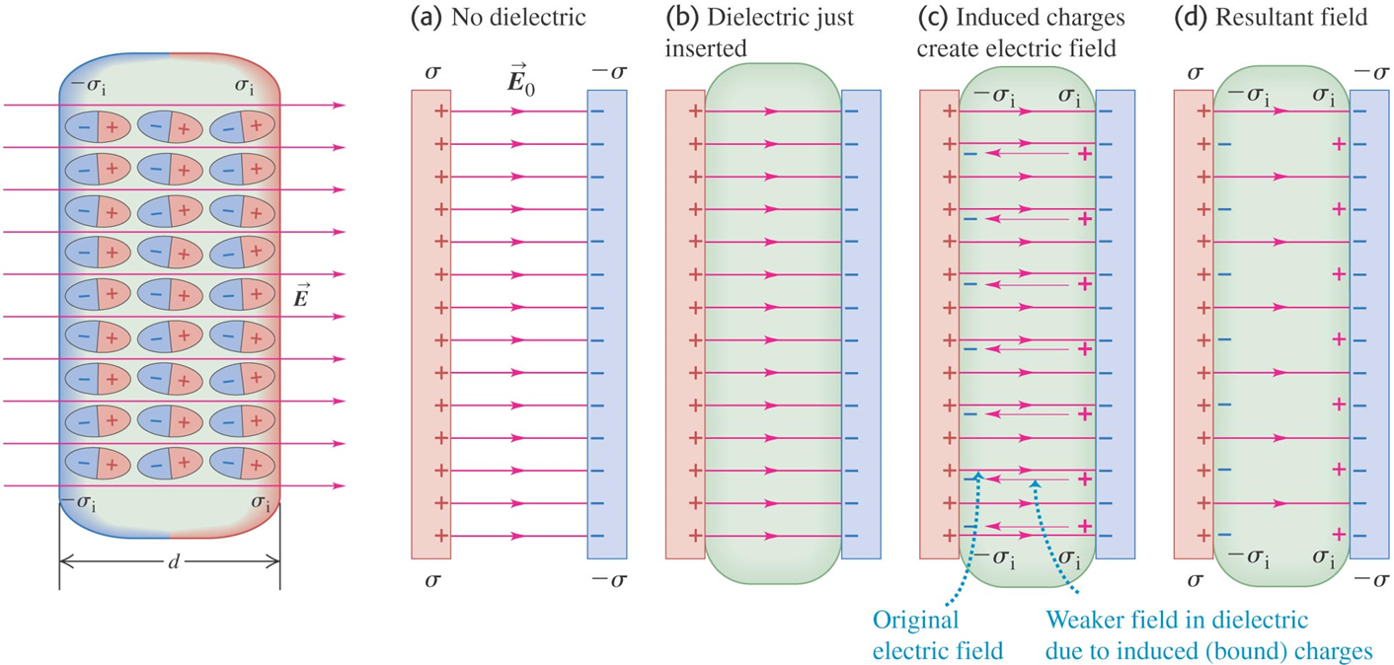
Dielectrics: Polarization

Slide 15
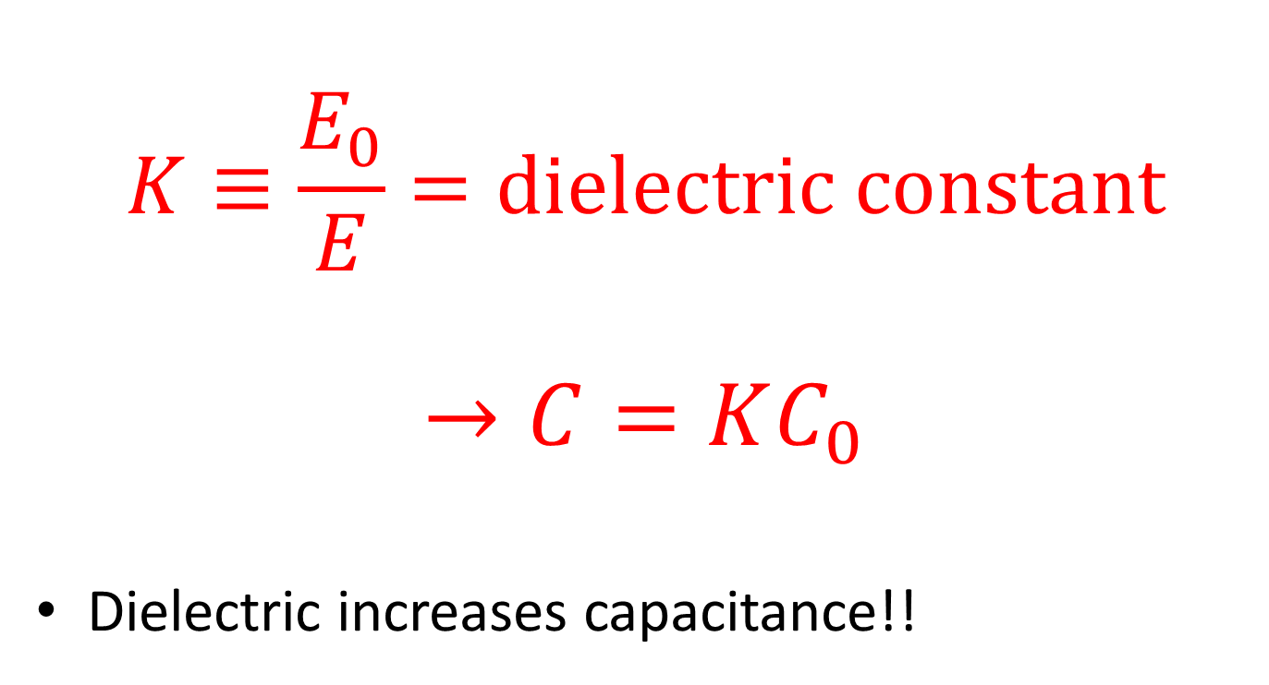
Dielectrics and Capacitors
$$K≡\frac{E_{0}}{E}=\text{dielectric} \text{constant}$$
$$→C=KC_{0}$$
Dielectric increases capacitance!!

Slide 16
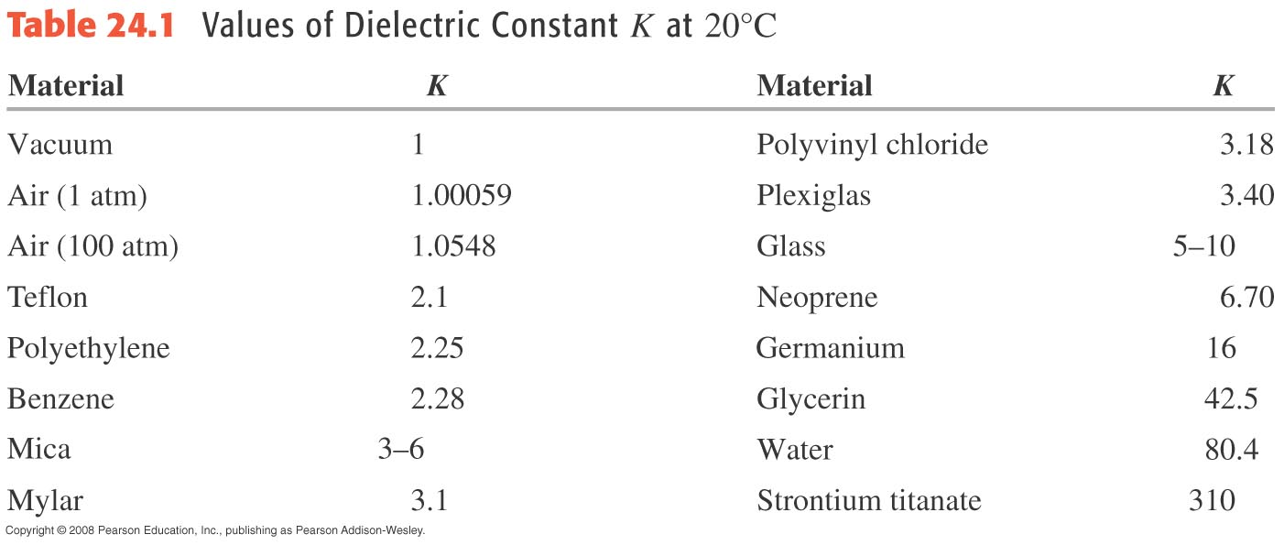
Table 24.1—Dielectric constants

Slide 17
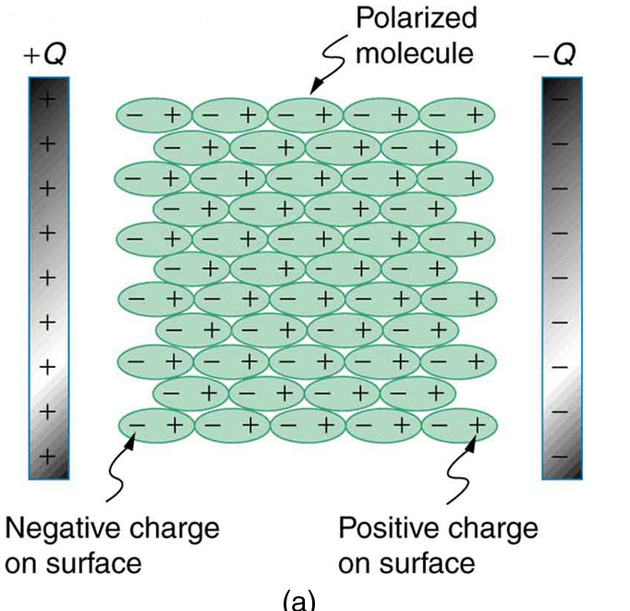

Permittivity
$$ε≡Kε_{0}$$

Slide 18
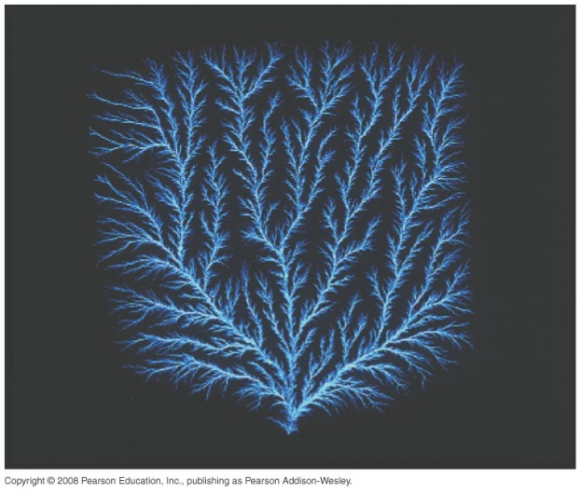
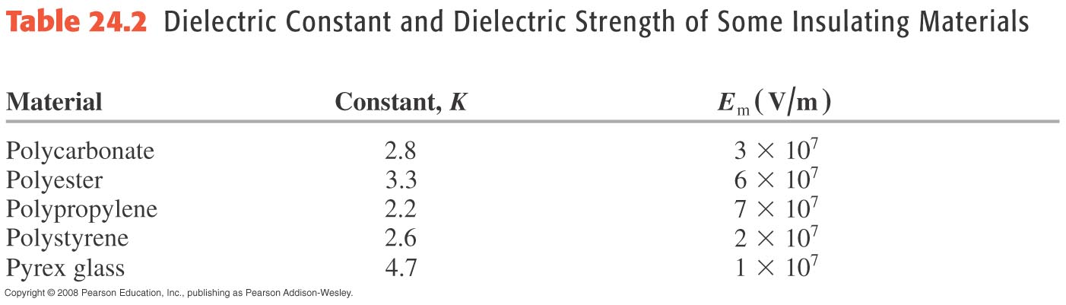
Dielectric breakdown:

Slide 19
Activity: Capacitor with a Dielectric

Slide 20
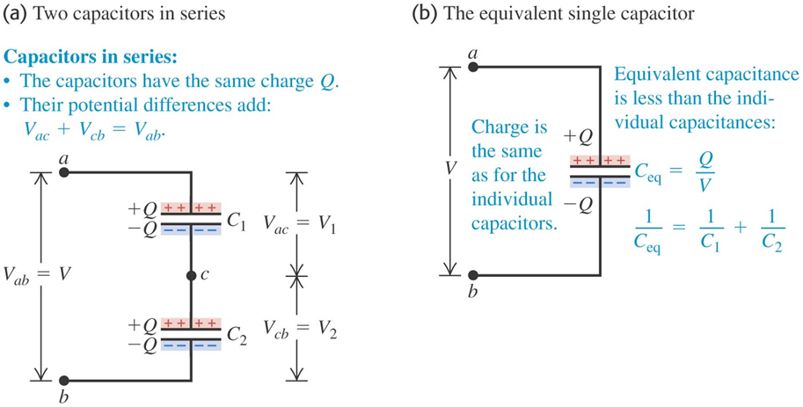
Multiple Capacitors: Series
Charge on each capacitor is the same

Slide 21
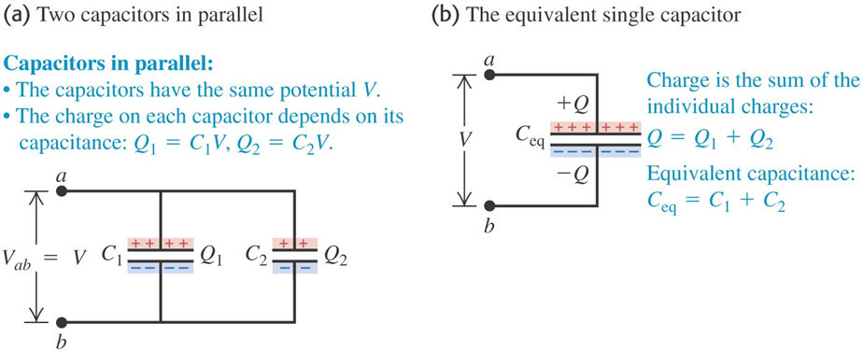
Multiple Capacitors: Parallel
Voltage across each capacitor is the same

Slide 22
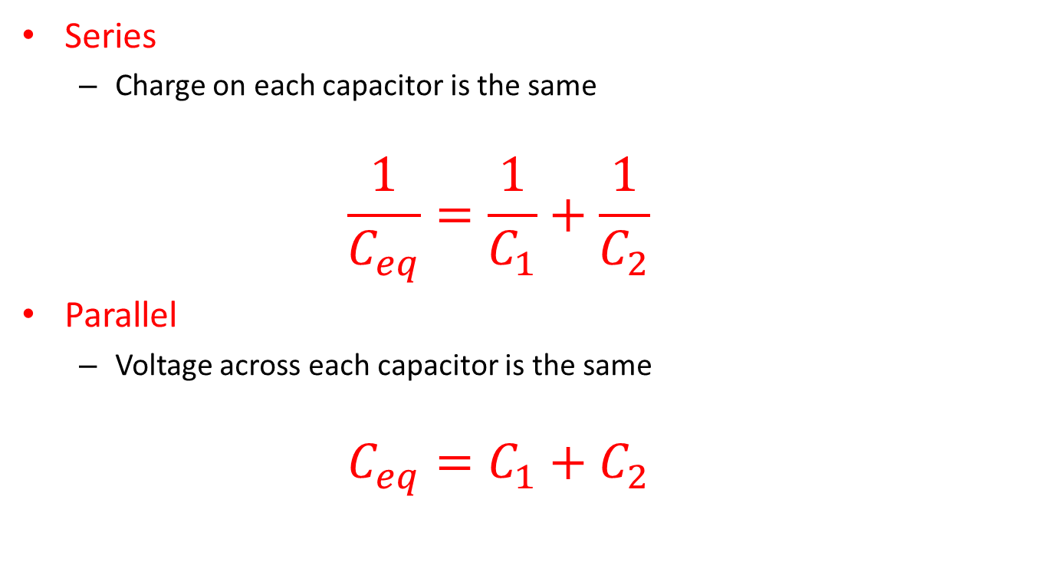
Series and Parallel Capacitors: Equivalent Capacitance
Series
Charge on each capacitor is the same
$$\frac{1}{C_{eq}}=\frac{1}{C_{1}}+\frac{1}{C_{2}}$$
Parallel
Voltage across each capacitor is the same
$$C_{eq}=C_{1}+C_{2}$$

Slide 23
Example Problem: Equivalent Capacitance

Slide 24
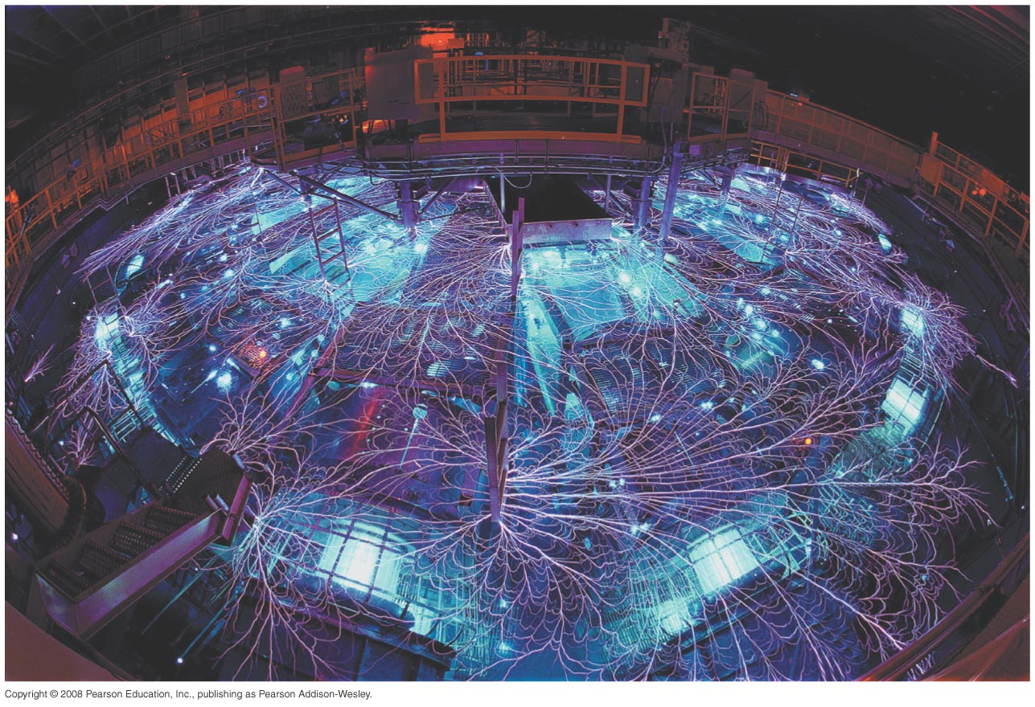
The Z Machine – Sandia National Lab in New Mexico
Large array of capacitors in parallel
Total Stored Energy: 20 MJ
When directed at a target, discharge generates temperatures on the order of 10⁹K!

Slide 25
Activity: Capacitors in Series and Parallel

